Slide 1
NLP 101
- Your Primer for NLP quick overview

Slide 2

What is NLP?
Field of Computer science that processes human language to derive useful insights
Source : https://www.lexalytics.com/lexablog/machine-learning-natural-language-processing

Slide 3
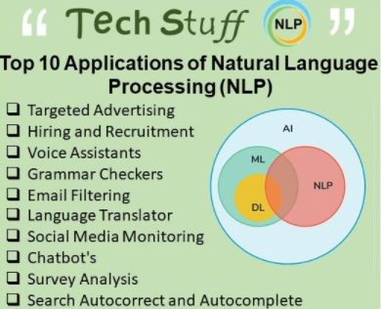
Real World Use case

Slide 4
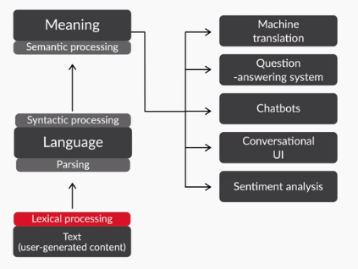
Stages of NLP

Slide 5
Lexical Processing
convert the raw text into words/ sentences/ Paras.
Eg: spam detection
Group of words Concept
“My cat ate its third meal” and
“My third cat ate its meal”
Lexical processing :-
My , cat , ate , its , third , meal

Slide 6
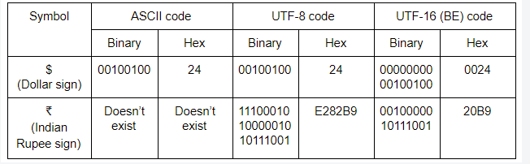
Text Encoding
All the non-numeric characters encoded to a number using a code.
Two most popular encoding standards:
American Standard Code for Information Interchange (ASCII)
Unicode
UTF-8
UTF-16

Slide 7
Preprocess Corpus
Tokenisation
Stop words removal
Stemming
Lemmatization

Slide 8
Tokenization
Noise is in the form of non-uniform cases, punctuations, spelling errors.
Technique used to split the text into smaller elements: characters, words, sentences, or even paragraphs.
NLTK package in python (contraction word : can’t ,don’t)
Word tokeniser , Sentence tokeniser , Tweet tokeniser , Regex tokeniser .

Slide 9
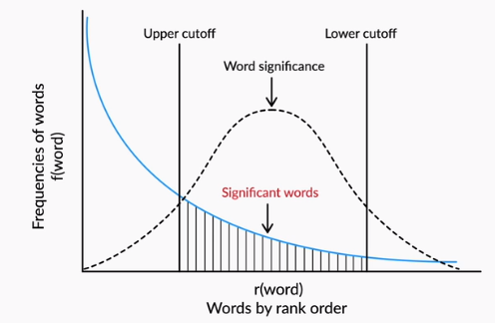
word frequency distribution
visualizing the word occurrence of a given text corpus.
Zipf's law : frequency of a word is inversely proportional to the rank of the word. (power law distribution)

Slide 10
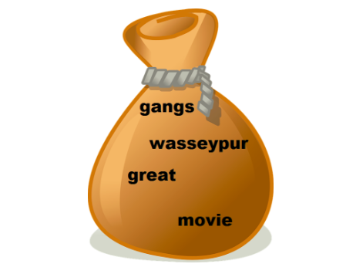
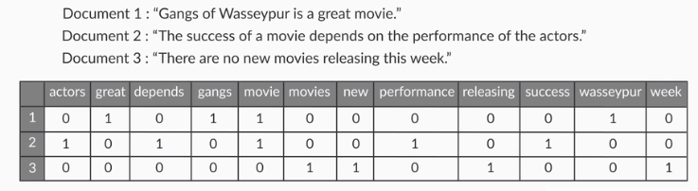
Word Representation: Bag-of-words(BOW)
Any given piece of text can be “represented” by a list of all the words that occur in it.
sequence of occurrence does not matter
scikit-learn library in python

Slide 11
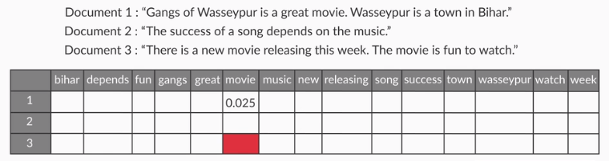
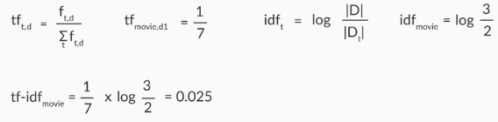
TF-IDF Model
Accounts the importance of each word while in BOW all words are equally important.
Higher weights : frequently in a document and which are rare among all document
low score : common across all documents.

Slide 12
Challenges
Redundant features : ‘get’ , ‘getting’, ‘goes’ and ‘going’
“curse of dimensionality” : under performance of Algorithm/inefficient model
[canonicalization] Two more preprocessing techniques -
stemming and lemmatization
Different variations of a word, say ‘warm’, warmer’, ‘warming’ and ‘warmed,’ are represented by a single token.

Slide 13
Stemming
Rule-based technique that chops off the suffix of a word to get its root form, which is called the ‘stem’.
Eg : ‘drive’, ‘driving’, etc. to ‘driv’, and ‘race’, ‘racer’, etc. to ‘rac’
Two types :
Porter stemmer: Read For More
Snowball stemmer: Read For More

Slide 14
Lemmatization
Searches for the input word’s base word by going recursively through all the variations of dictionary words.
Eg: ‘feet’, ‘drove’, ‘arose’, ‘bought’ can’t be reduced to lemma
The part-of-speech tag of the input word (noun, verb, adjective etc.) is needed here.
Correct dictionary spelling.
WordNet lemmatizer : Read For More

Slide 15
Additional Preprocessing
Problem (Misspelled words)
Eg : ‘dissappearng’ and ’disappearing’.
Solution : Edit distance
Problem (Valid different spellings)
Eg: colouring’ and ‘coloring’ .
Solution : phonetic hashing

Slide 16
Syntactic Processing
extract more meaning from the sentence, by using its syntax /grammatical structure of sentences
Eg: Analysis based on sentence’s subjects and objects
“Ram thanked Shyam” and
“Shyam thanked Ram”
Eg: “Who is the Prime Minister of India?”

Slide 17
Building Blocks
Basics of grammar (part-of-speech tags etc.)
Eg : HMMs (Hidden Markov Model) to build POS taggers.
Parse the grammatical structure of sentences
Eg : CFGs(context-free grammars), PCFGs (probabilistic context-free grammars) and dependency parsing

Slide 18
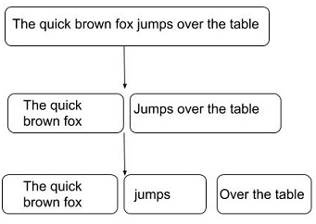
Parsing
Break down a given sentence into its 'grammatical constituents’.
'The quick brown fox' is a noun phrase
'jumps' is a verb phrase
'over the table' is a prepositional phrase.
Two Types of Parsing:
Shallow Parsing
Deep Parsing

Slide 19

POS tagging
Task of assigning a part of speech tag (POS tag) to each word.
Identify the linguistic role of the word in the sentence

Slide 20
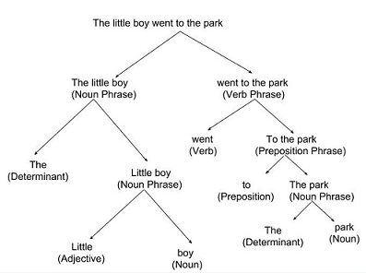
Constituency parsers
Divide the sentence into constituent phrases such as noun phrase, verb phrase, prepositional phrase etc

Slide 21
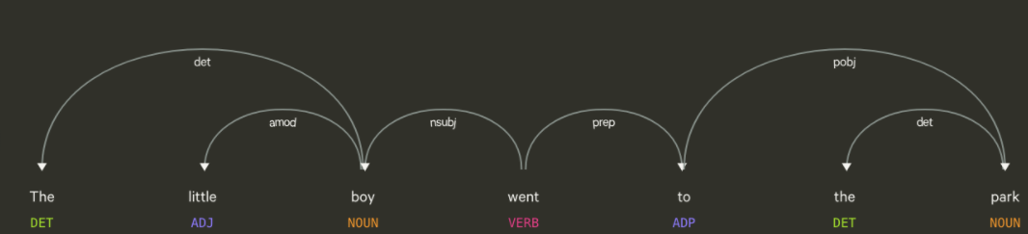
Dependency Parsers
Establish relationships directly between the words themselves.

Slide 22
Semantic Processing
Inferring the word’s meaning to the collection of words that usually occur around it.
Eg : “Who is the PM of India?” and
“Who is the Prime Minister of India?”
Machine should be able to identify synonyms, antonyms, etc. on its own.
Eg : “King” and “Queen” relation & clubbed under the word “Monarch”

Slide 23
Need for Semantics
"Croatia fought hard before succumbing to France's deadly attack; lost the finals 2 goals to 4“
context of the text/topics being talked about
- Text is about football and the FIFA world cup final, even though the words 'football' and 'FIFA' are not mentioned in the sentence.
disambiguate between multiple possible senses
- The words 'succumb' and 'goal' are used differently than in the sentences 'He succumbed to head injuries and died on the spot' and 'My life goals'.

Slide 24
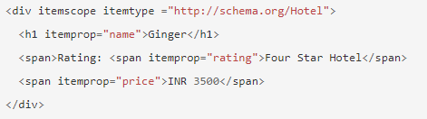
Example 1
schematic structure
Eg : Schema.org is a joint effort by Google, Yahoo, Bing and Yandex (Russian search engine) to create a large schema relating the most commonly occurring entities on web pages
“Hotel Ginger”

Slide 25
Example 2
Lesk algorithm
Helps in finding the 'correct' meaning.
Eg : Rohan’s money bank is blue in colour.
The bank is closed on Sunday.
The word 'bank 'can have multiple meanings depending on the surrounding (or the context) words

